Slide 1

Drexel University & College of Medicine
Advanced Procurement
June 2010

Slide 2
Universities’ Commitment
“. . .The University and its Trustees, officers, agents and representatives are obligated to avoid conflicts of interest, and perceived conflicts of interest, in the procurement of goods and services for the University. . .”
(excerpted from: Drexel University Board of Trustees Reaffirmation of Procurement Policy - http://www.drexel.edu/procurement/about/)

Slide 3
Conflict of Interest
No detriment to the University results from conflicts between a college, department, or individual interests and those of the University
Complete Policy can be found:
http://www.drexel.edu/hr/resources/policies/dupolicies/ogc1/

Slide 4
Ethical Procurement (cont’d)
“As an institution of higher learning, Drexel University is additionally committed to conducting its affairs in complete accordance with applicable professional and ethical standards. . .”
(excerpted from: Drexel University Board of Trustees Reaffirmation of Procurement Policy)

Slide 5
Drexel’s Code of Ethics
Issued by Tom Elzey, Sr. VP & CFO
Complete Code can be found at: http://www.drexel.edu/papadakis/sarbanes/MEMO_TO_EMPLOYEES.pdf
7. The executive should act at all times in adherence to this code and insist upon the compliance of each of his or her subordinates. . .” (excerpt from Code)

Slide 6
University’s Purchasing Philosophy
The University has a decentralized purchasing process that utilizes contracts for goods and services which strategically leverages the University’s buying power.
We strive to provide the necessary buying tools, training, and support to effectively, efficiently, and ethically purchase products and services.

Slide 7

Diversity Vendors
Drexel’s Partnership – MBEC
Grants
Government Relations
Future

Slide 8
Contract Protocol
http://drexel.edu/hr/resources/policies/ducompolicies/ogc3/
  types of contracts MAY NOT be signed without review by the OGC
  types of contracts MAY be signed without review by the OGC
  The authority to sign contracts on behalf of the University shall be as per applicable University Signature Authority Policy and Procedures.

Slide 9
University Procurement Website
www.drexel.edu/procurement

Slide 10
Spending Guidelines
$2,500.01 - $5,000.00
  One additional verbal competitive bid*
$5,000.01 - $25,000.00
  Two additional written competitive bids* (attached as separate documents) should be submitted
Note: If a department or person is not able to obtain additional competitive bids, University Procurement will assist in acquiring these documents. Competitive bid exceptions may apply.

Slide 11
Quotes & Bids
$25,000.01 and above–University Procurement must be involved in preparing a formal Request for Quotation (RFQ) or Request for Proposal (RFP)

Slide 12
Requests for Quotes (RFQs)
Typically used to identify the vendor who can meet the buyer’s requirements for the best price for goods.

Slide 13
Requests for Quotes (RFQs)
The product(s) should be described in detail.
Specifications should be clear, concise and complete.
Quantity, quality requirements, packaging, F.O.B. point, payment terms, and warranty, delivery should all be included in the RFQ

Slide 14
Requests for Proposals (RFPs)
Typically used for services (consulting, advertising, publication, maintenance, construction, etc.)

Slide 15
CONSULTANTS
Justification required before engaging consultants
Information on the consultant selected, along with a justification for the selection based on the technical details of the project.
Letter must be signed by individual with signature authority for the amount

Slide 16
Requests for Proposals (RFPs)
Introduction and Intent
Project Scope of Work, Technical Requirements and Specifications, & Bidding Instructions
General Provisions of Bid
General Terms & Conditions

Slide 17
Requests for Proposals (RFPs)
General Conditions and Terms for Any Agreement that Results from This Bid
  Independent Contractor Service Provider Agreement http://www.drexel.edu/depts/compt/tax/ic_info.html
  Certification
Service Provider Insurance Coverage Info

Slide 18
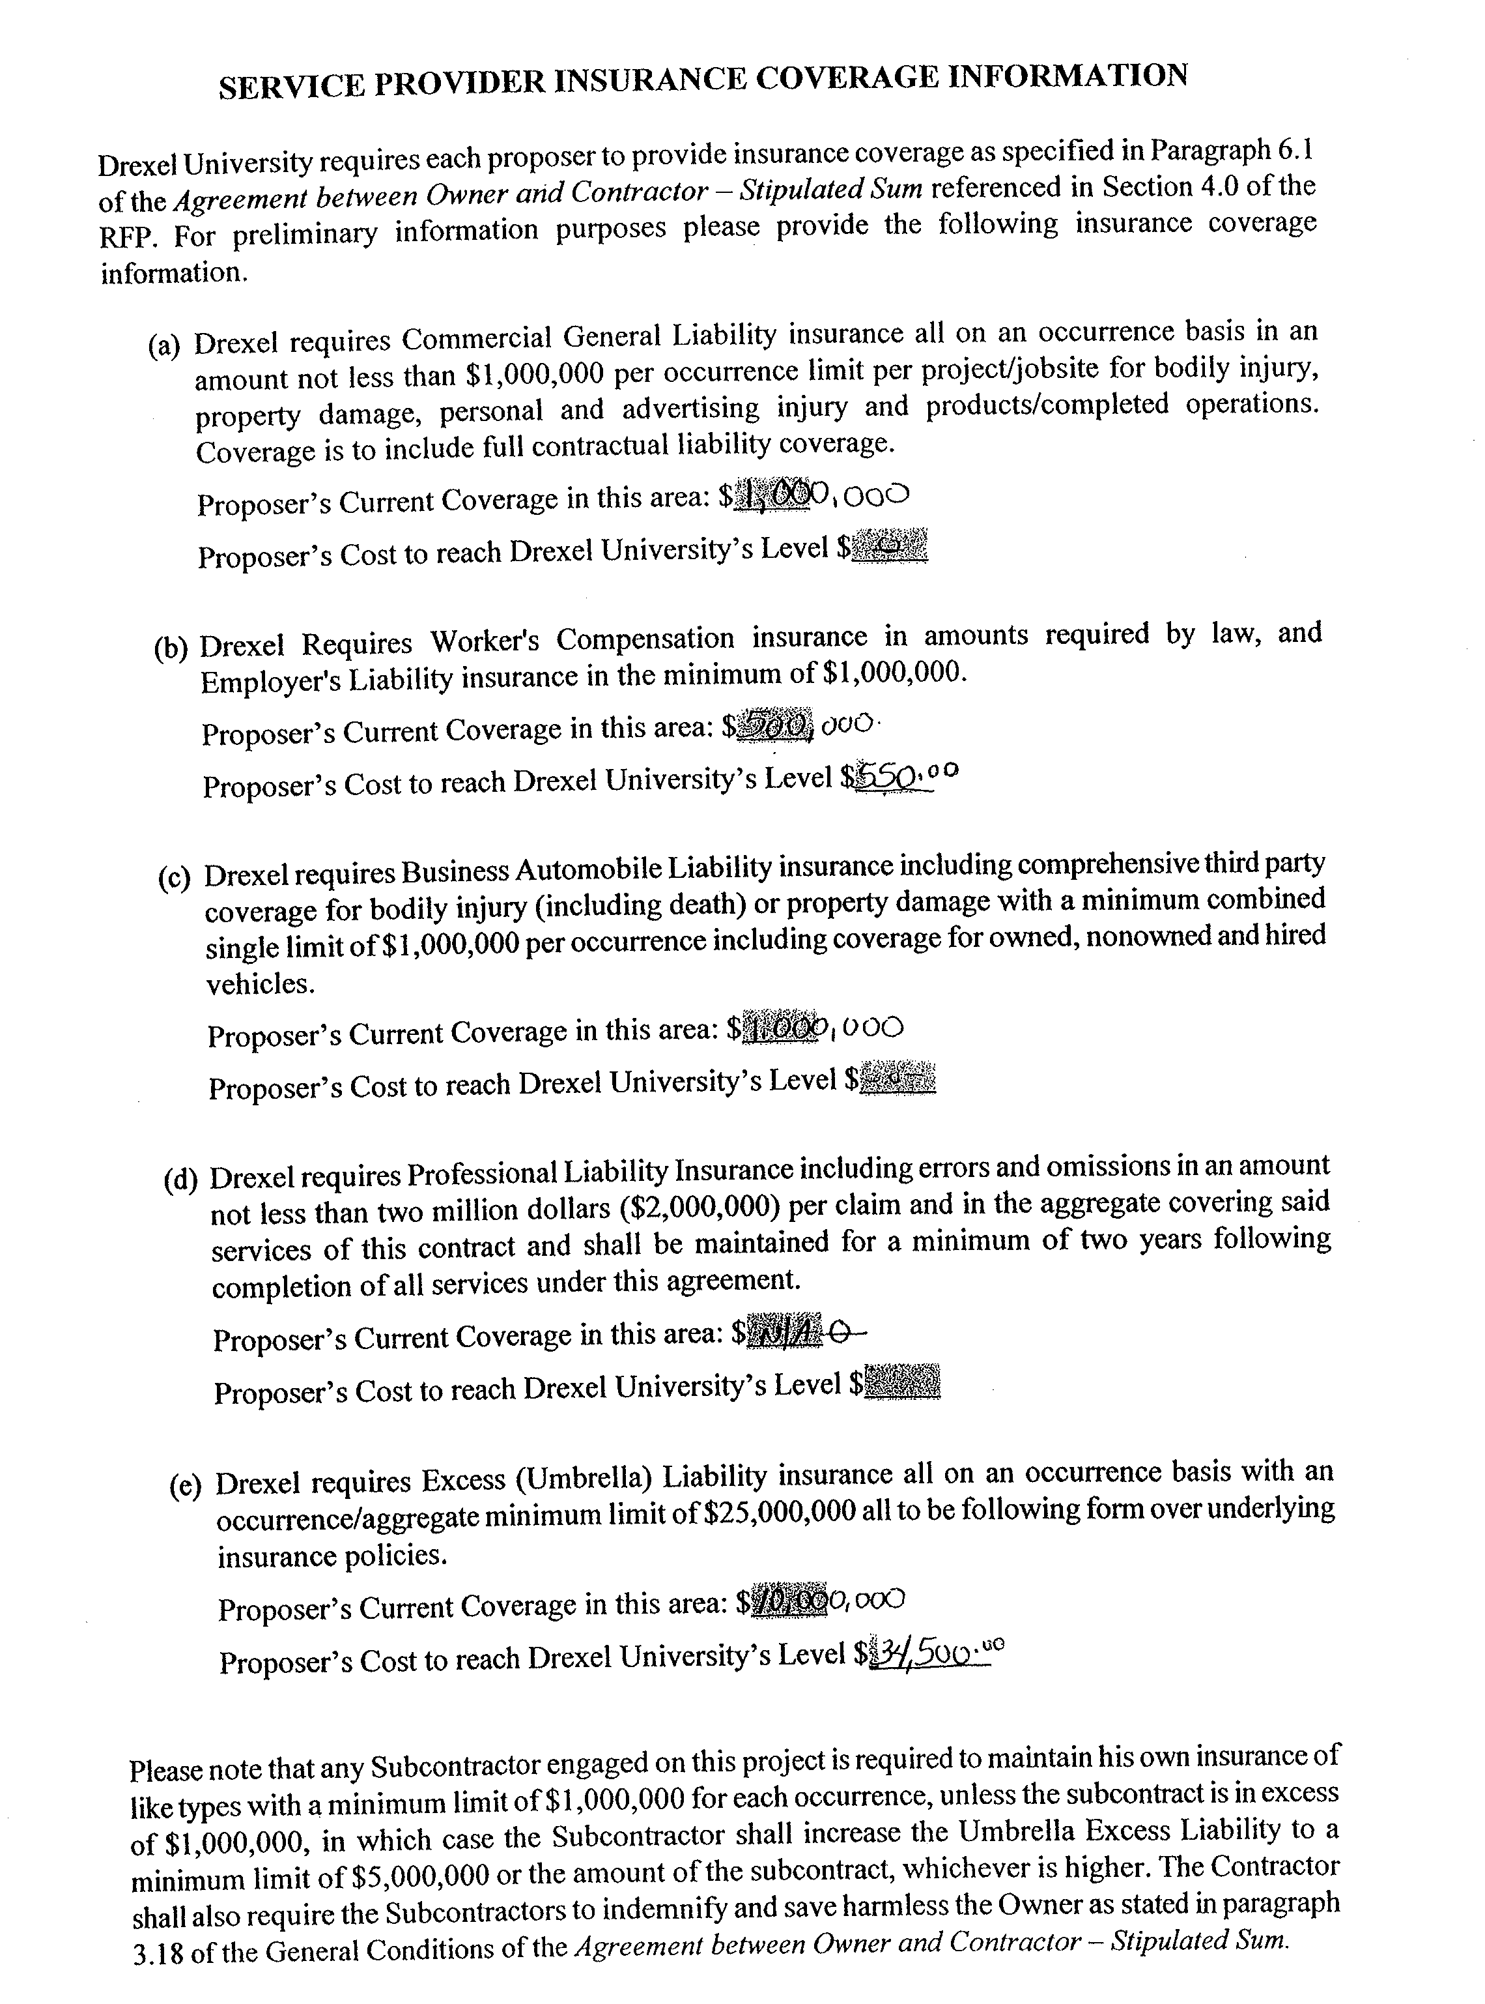

Slide 19
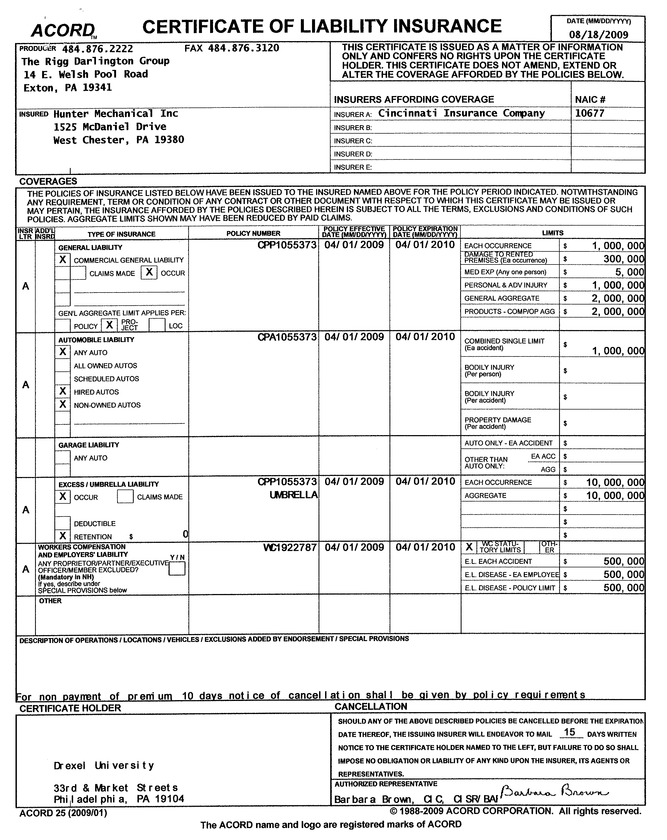

Slide 20
WHAT IS Sole Source?
Specific products or services available from only ONE source; also called sole provider, sole supplier, sole vendor, or sole distributor

Slide 21
Competitive Bid Exception Guidelines
Emergencies
Uniqueness
Proprietary
Availability
Compatibility

Slide 22
Sole Source/Competitive Bid Exception Guidelines
Justification Form required
  Because the requestor is asking for an exception, due diligence requires that we ensure the next level approver is aware of this exception request; in other words, they countersign the justification statement.

Slide 23
Purchasing using Research/Grant Funding
http://www.research.drexel.edu/administration/Project_Administration/Financial%20Administration/Default.aspx
Pre-approval (regardless of dollar level)
  Subcontracts
  Consulting & purchased service agreements
  Equipment
  Hardware and Software
Pre-approval ($2000.00 or above)
  Purchase Requests/PCard transactions

Slide 24
Taxes (Sales, Use, etc.)
Typically sales tax exemption laws are complex. Please contact our Tax Office for help with what is and is not taxable
http://www.drexel.edu/depts/compt/tax/index.html
  If one is charged sales tax erroneously, e.g., PCard transaction, it is the department’s responsibility to recover
Sales Tax exemption certificates can be obtained from the Tax Office

Slide 25
Helpful Resources
Previous presentations are available on our website
  http://www.drexel.edu/procurement/training/
Credit Applications/References
  Request specific Credit Letters from procure@drexel.edu

Slide 26
Travel Policies/Forms
Established by the Comptroller’s Office
  Direct any travel policy questions to Accounts Payable or refer to “Other Resources” via our Travel Portal
    http://www.drexel.edu/procurement/travel/

Slide 27
Travel Portal
Established by University Procurement
Interim President C.R. Pennoni’s June 23, 2009 Cost Containment memo directed all travelers to utilize the portal and our agent, Marathon Travel
  Justification is required (counter-signed by whomever approves your travel) if you utilize a different agent.

Slide 28
Travel Portal
Advantages of Marathon:
  Choice
    Internet assisted or Agent assisted reservations
  Lowest fare guaranteed
  24 hour emergency worldwide travel hotline
  Concierge services
  24 hour roadside assistance service
  http://www.drexel.edu/procurement/travel/

Slide 29
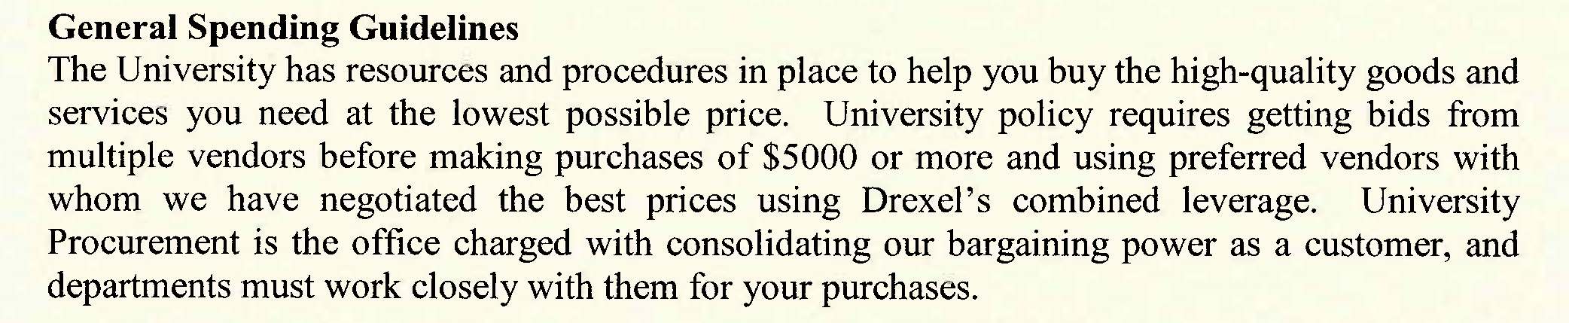
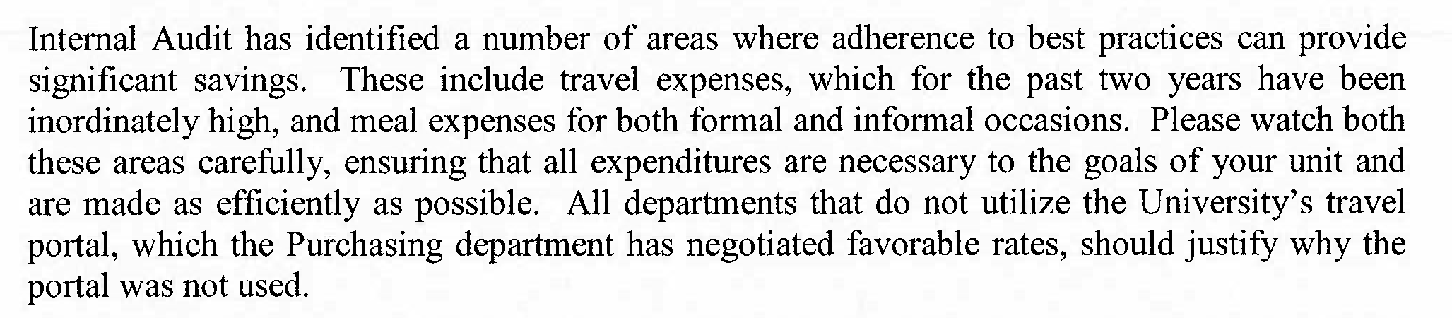
Excerpt: Letter from President Dated June23, 2009
Addressed to President’s Cabinet, Subject “Cost Containment

Slide 30
Contacts
  Joe Campbell, jac47@drexel.edu
  Debbie Rizzo, dma49@drexel.edu
  Anna Griffin, ag87@drexel.edu
  James Davis, jbd52@drexel.edu
  Charlene Rice, ricec@drexel.edu
  Carmen Spears, spearsce@drexel.edu
  Una Massenburg, umm23@drexel.edu
  Michele Arias-Ramos, ma484@drexel.edu
  Kathleen Maertzig, kam39@drexel.edu

Slide 31
Further Information
www.drexel.edu/procurement
procure@drexel.edu

Slide 32
Questions & Concerns

